Slide 1
All Recipes
Rena Nguyen

Slide 2
Mini Update #1- Data Profile (Revised)
There are two datasets for the project: All_Recipes and Cuisines. All_Recipes (first table) includes 14426 rows and 16 columns. Cuisines (second table) includes 2218 rows and 17 columns.
Column Name | Has missing value? | Data Type (Discrete or numeric or free text) | Useful? | Need cleaning or processing?
Name | No | Free Text | No | No
URL | No | Free Text | No | No
Author | No | Free Text | No | No
Date Published | No | Free Text | No | No
Ingredients | No | Free Text | No | No
Calories/Fat/Carbs/Protein | Yes | Discrete | Yes | Yes

Slide 3
Mini Update #1- Data Profile (Continued)
There are two datasets for the project: All_Recipes and Cuisines. All_Recipes (first table) includes 14426 rows and 16 columns. Cuisines (second table) includes 2218 rows and 17 columns.
Column Name | Has missing value? | Data Type (Discrete or numeric or free text) | Useful? | Need cleaning or processing?
Average Rating | Yes | Numeric | Yes | Yes
Total Rating | Yes | Discrete | Yes | Yes
Reviews | Yes | Discrete | Yes | Yes
Prep Time/Cook Time/Total TIme | No | Discrete | Yes | No
Servings | No | Discrete | Yes | No
Country | No | Free Text | Yes | No

Slide 4
Mini Update #1 - Curious Questions
Curious Questions:
Which recipe has the highest _____ or lowest _____?
Are there any recipes with low calories but high protein?
Is there any recipes with high ratings but a low number of ratings? (and vice versa)
Could nutritional values in recipes influence the ratings? (whether that would be average, total, number, or a combination)
Audience - Generally, these datasets can cater to anyone and everyone, to bakers and chefs to non-bakers and non-chefs.
Communication Goal - The main goal with these datasets is to improve understanding. A possible additional goal could be to induce action to see if these datasets could possibly influence someone to try out one of these recipes? (Or to begin cooking/baking in general)

Slide 5
Mini Update #2 - Data Insight #1
Because I have two datasets, I decided to split each dataset into one slide. This slide will be centered around the All_Recipes dataset.
 | Lowest | Highest
Calories | 1 | 9538
Fat | 0 | 612
Carbs | 0 | 746
Protein | 0 | 939
The recipe with the highest calories also had the highest fat and protein. However, it accumulated a two star rating from only one review. With the recipe that had the highest amount of carbs, it also had a high amount of calories. It accumulated an average rating of 4.3 from 3 reviews in total.

Slide 6
Mini Update #2 - Data Insight #2
Because I have two datasets, I decided to split each dataset into one slide. This slide will be centered around the Cuisines dataset.
 | Lowest | Highest
Calories | 3 | 2266
Fat | 0 | 225
Carbs | 1 | 264
Protein | 0 | 159
The recipe with the highest calories was associated with a high total time (for cooking). It also accumulated an average of 4.6 for ratings and 22 reviews overall. The recipe with the highest fat had a high amount of calories but did not have any reviews and ratings. The recipe with the highest carbs also had a high amount of calories but only had one review. As for the recipe with the highest protein, it had a relatively moderate amount of calories and it accumulated an average of 4.4 as well as 61 reviews.

Slide 7
Mini Update #2 - Progress Check
I have accomplished thoroughly looking through the two datasets. I hope to be able to accomplish making at least one narrative of a data insight as well as an analysis.
Because these datasets revolve around cooking/baking, I find it to be hard to connect with it as I am unfamiliar with it. Although I chose these datasets to learn because choosing an easier dataset won’t give me a challenge.
I have only use JupyterLab so far.

Slide 8
Mini Update # 2 - Feedback
Feedback from Update #1 was mostly directed towards revising the data profile as well who my audience is and the communication goal.
I plan to address this feedback through doing a bit more background research on my data as well as the subject of my data.
I do think the feedback is useful. I saw that I did not specify on some parts and it is clear that my target audience is not fully developed yet.
I do seek feedback on whether what I have so far makes sense or is clear

Slide 9
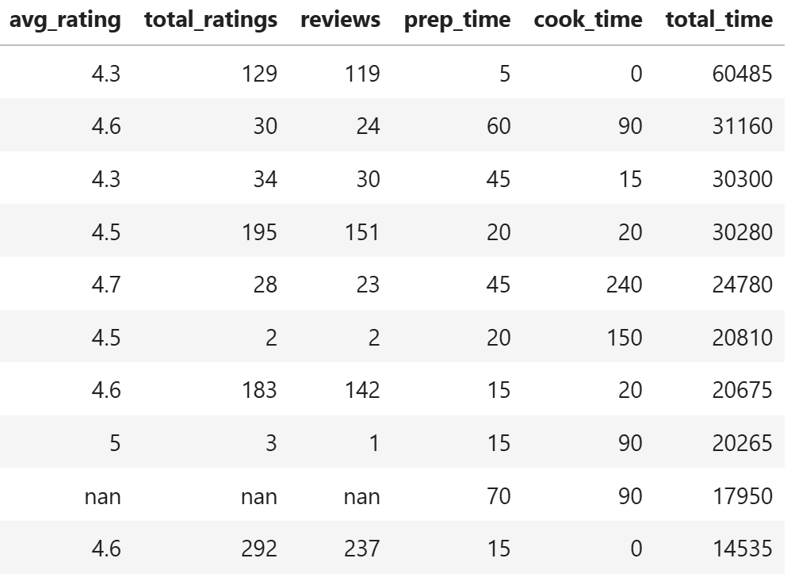
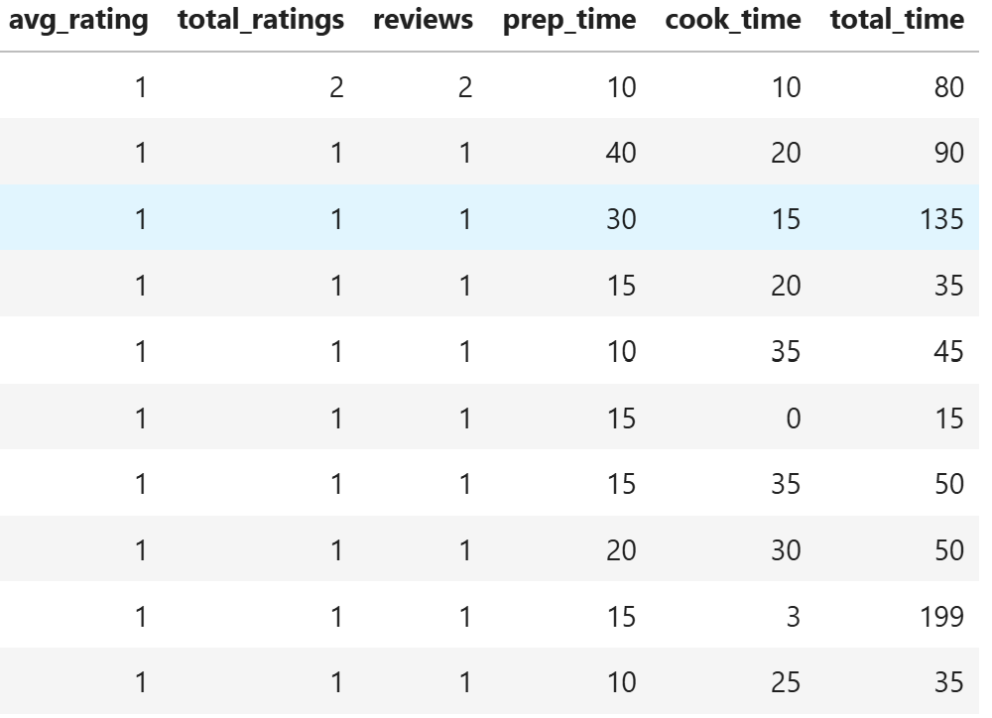
Mini Update #3 - Data Insight
Because I have two datasets, I decided to split each dataset into one slide. This slide will be centered around the All_Recipes dataset.
Here, this table demonstrates rows of recipes that contain the highest total times. Through these high total times, the average ratings seemed to be relatively high.
Here, this table demonstrates rows of recipes that contain the lowest average rating. These recipes seem to be influenced through their low total ratings and reviews. In comparison to the other table, these total times are much lower.

Slide 10
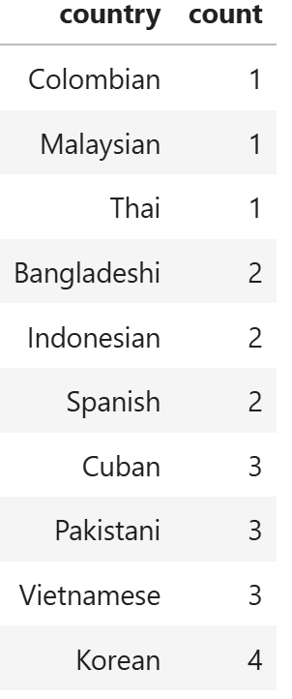
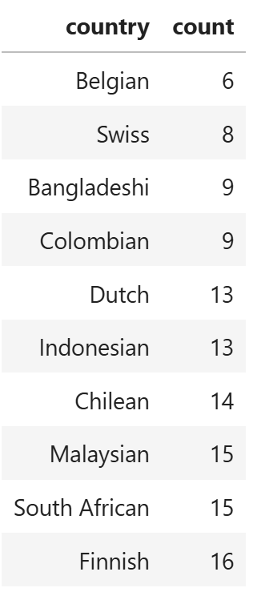
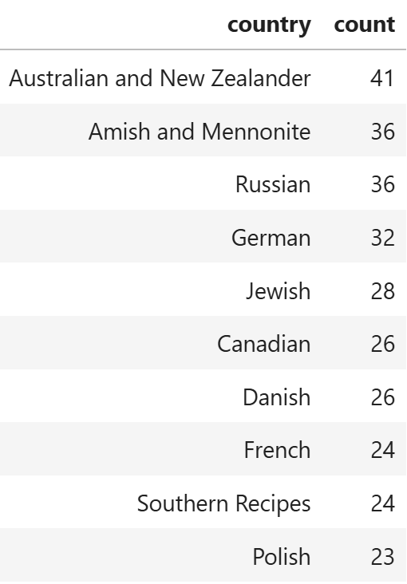
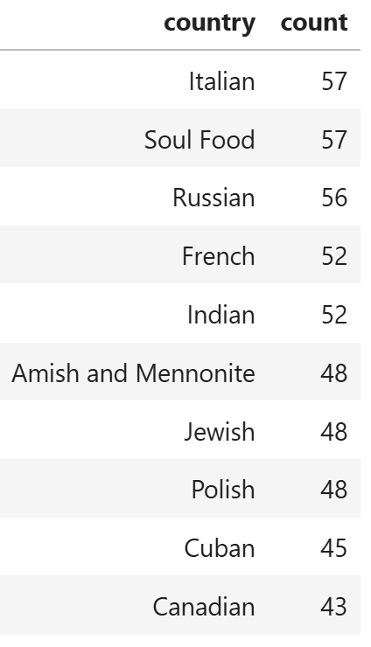
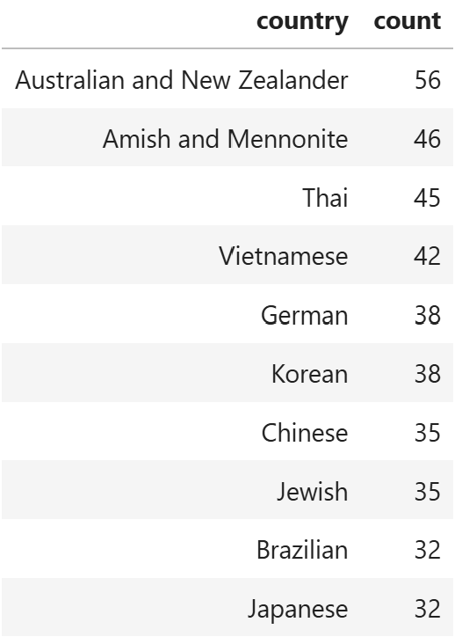
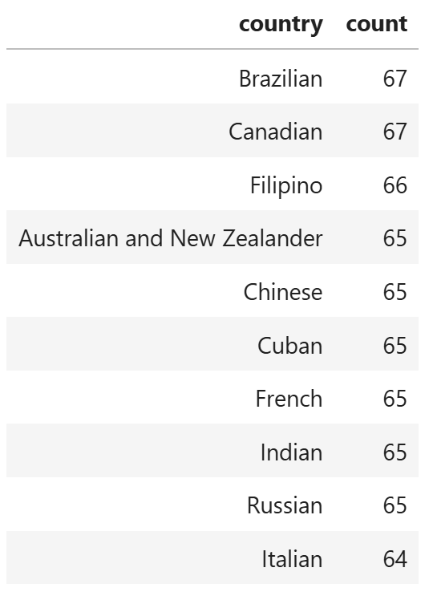
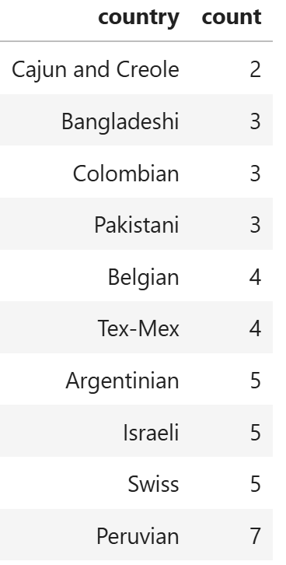
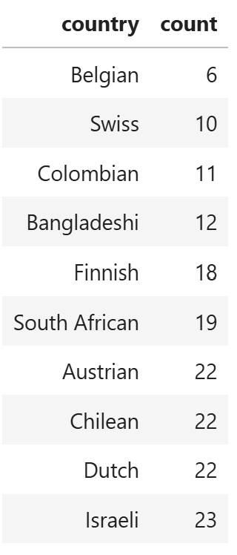
Mini Update #3 - Data Insight
Because I have two datasets, I decided to split each dataset into one slide. This slide will be centered around the Cuisines dataset.
Countries per cuisines that contain ‘salt’ as an ingredient.
Countries per cuisines that contain ‘sugar’ as an ingredient.
Countries per cuisines that contain ‘flour’ as an ingredient.
Overall counts of each cuisines per country
As there is many common ingredients in cooking/baking, I decided to scale it down to three ingredients: flour, salt, and sugar. Using these three ingredients, I sectioned the cuisines that had each ingredients and grouped together the countries. Through this process, it can be determined that certain countries dominate in having more of one ingredient than another. With flour, mostly European countries dominate in having flour in their cuisines while Asian and Latino countries have less. With salt, European countries along with a few other countries dominate in having salt whilst a mix of countries lack cuisines with salt as an ingredient. And with sugar, mostly Asian countries contain cuisines with sugar as an ingredient while a mix of european and latino countries lack of it.

Slide 11
Mini Update #3 - Progress Check
I went through each dataset, trying to pick out general patterns from each one. During skimming through each one, I did some background research, focusing particularly on what ingredients commonly show up and if there was any factors to recipes having higher ratings/reviews than others.
Additional data insights is needed for the next mini update as that update will be the last for insights
JuypterHub is the only one of use but there is a chance for Story Studio to be used in the next update

Slide 12
Mini Update #3 - Feedback
Feedback from last update focused more on trying to form data insights gathered from the two datasets
Background Research is still needed in order for me to truly confirm possible/potential narratives for my data insights
Feedback is useful as the data insights definitely could be improved
I still do seek feedback on whether everything makes sense and if there is potential for a narrative to be formed

Slide 13
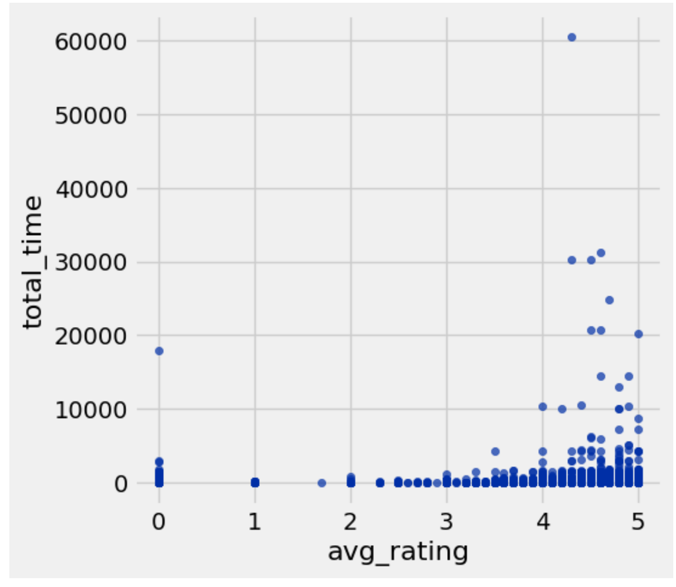
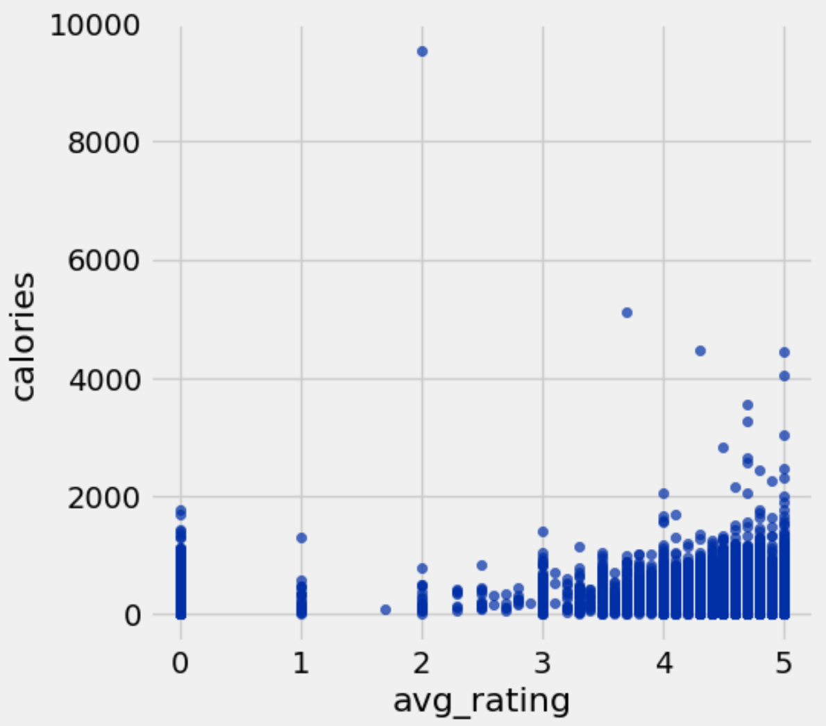
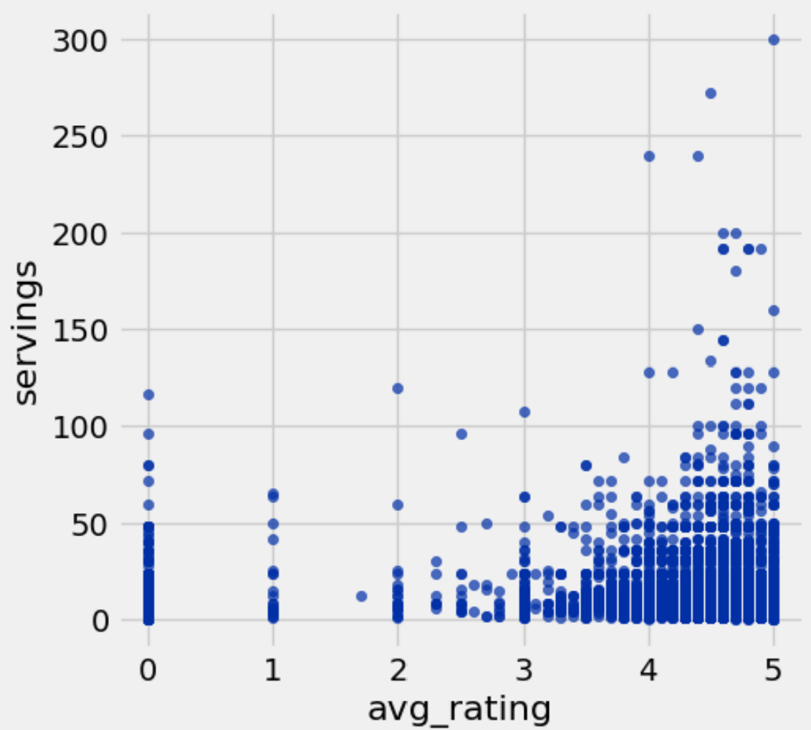
Mini Update #4 - Data Insight (All_Recipes)
The graph above shows the average ratings when it comes to their associated total times. As most of the average ratings are 3-5 and most of them lie below 10000 minutes or 6 days, this shows that there is little effect in total time towards average ratings.
The graph above shows the average ratings when it comes to their associated calories. As most of the average ratings are 3-5 and most of them lie below 2000 calories, it can be assumed that there is little effect that calories can have on average ratings. Although, recipes with higher calories than the rest does appear to have high average ratings.
The graph above shows the average ratings when it comes to their associated serving sizes. Most of these recipes falls below 50 servings with some outliers being above 50. Because of this, it can be assumed that there is little effect that serving sizes has on ratings. But, higher serving sizes does seem to have high average ratings.

Slide 14
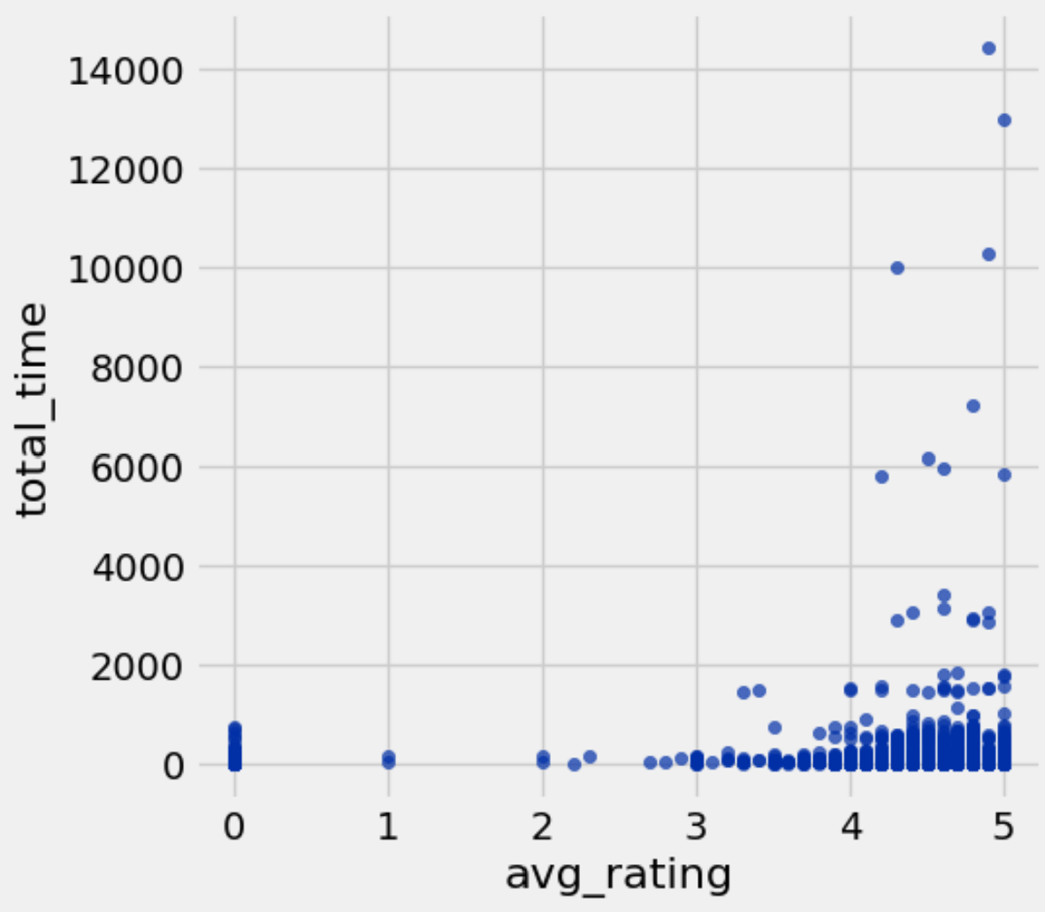
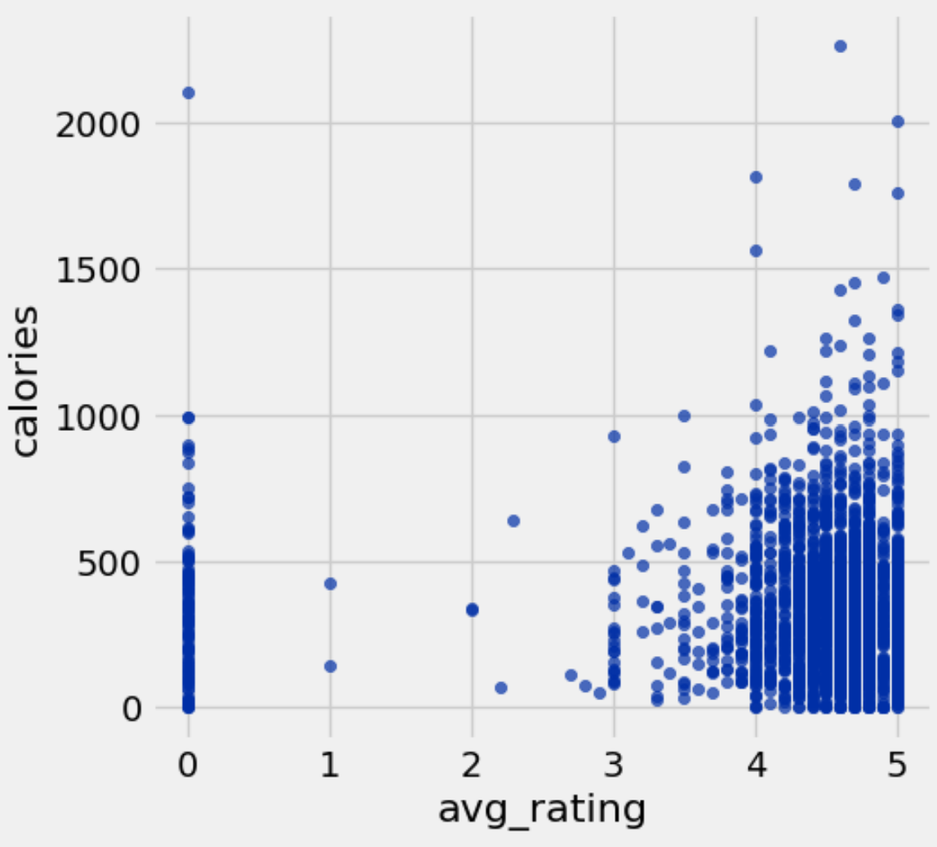
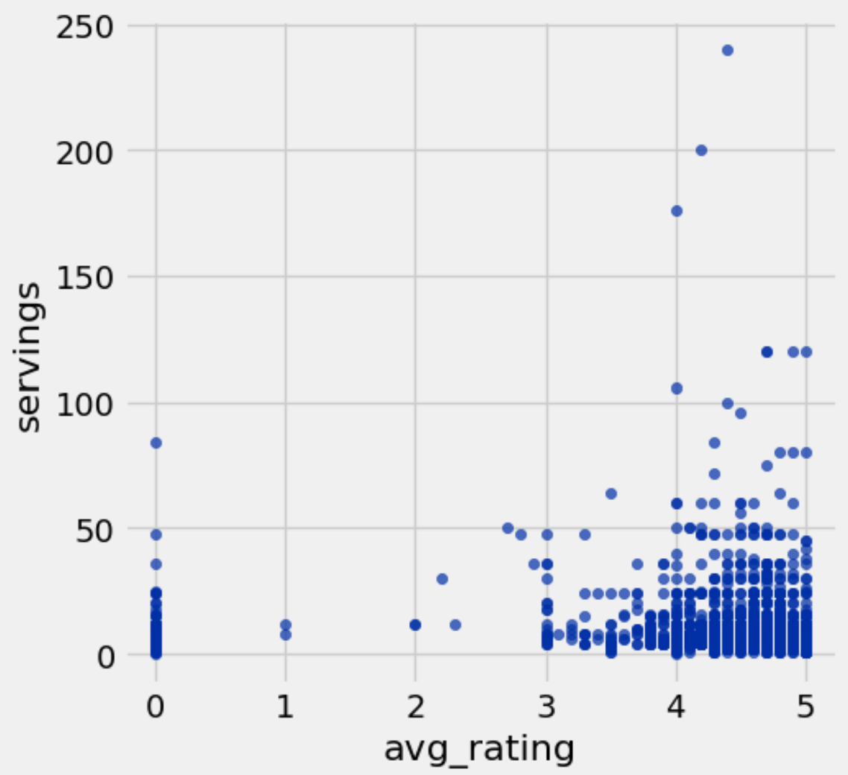
Mini Update #4 - Data Insight (Cuisines)
The graph aboves shows the average ratings when it comes to their associated total times. Most of the average ratings lies between 3 and 5. Alongside, most of the total times lies below 2000 minutes or approximately 33 hours. Because most of the ratings lies around each other, this means that there is no affect of total times to the average ratings to cuisine recipes.
The graph aboves shows the average ratings when it comes to their associated calories. Most of the associated calories fall just below of 1000 calories. Because of this, it can be determined that calories does not have an affect on average ratings.
The graph aboves shows the average ratings when it comes to their serving size. As the serving size for most of these recipes fall below 50 serving size, this can mean that serving sizes has no effect on the ratings.

Slide 15
Mini Update #4 - Progress Check
I did more of a deep dive through each datasets. I wanted to do more but I did not know how exactly to code it (such as coding the mean of the average ratings for each country in the cuisine dataset).
I’m considering using just one dataset instead of the both of them
I did try my best to attempt using Story Studio with this update alongside JupyterHub.

Slide 16
Mini Update #4 - Feedback
There was little feedback but it reminded me that I needed to do more than just providing tables for these updates.
I don’t necessarily seek any specific type of feedback
The feedback is useful (reasoning in first statement)

Slide 17
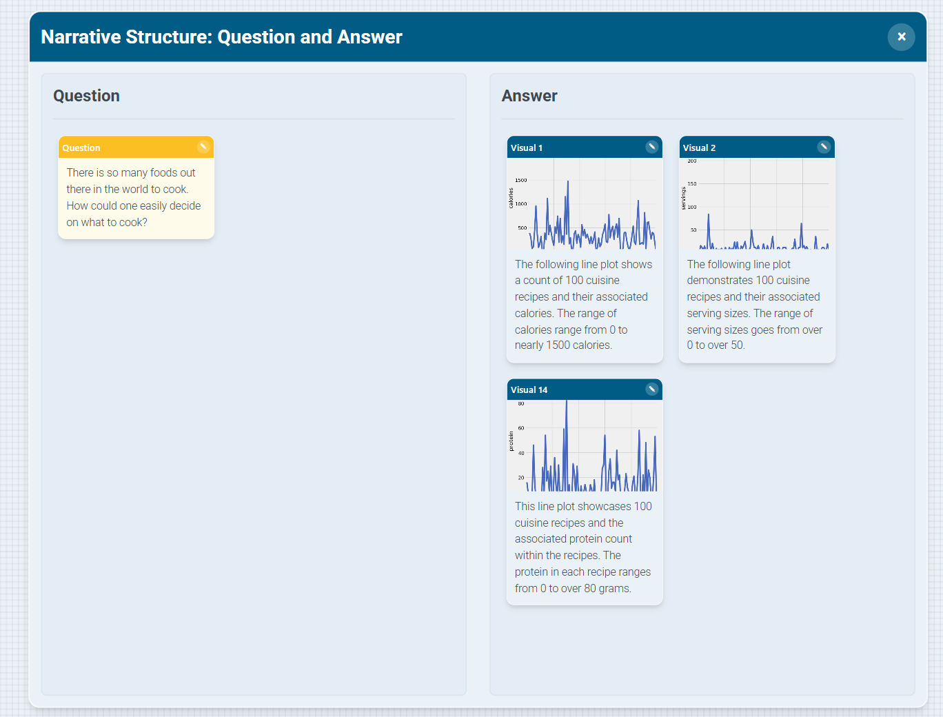
Mini Update #5
As this update required a storyboard, I decided to pivot towards doing a question and answer as the narrative structure. Through this update, I decided to create a few more data insights by creating line plots rather than the past scatter plots.
My Question here could be developed into a storyline if I could decide which data insights could also fit inside the answer side.

Slide 18
Mini Update #5 - Progress Check
Storyboard is beginning to be developed. A storyline is in the works of being developed if the right data insights are picked to cater to it.
No obstacles as of right now
Story Studio and JuypterHub was used

Slide 19
Mini Update #5 - Feedback
The feedback relied mostly on the scatter plots I generated.
Through this feedback, it pointed outliers and non-optimal plots. As this is a result of trying to data clean (through replacing nan values with 0), I could try again through deleting rows that include nan values.
Feedback is useful as it pointed out how odd it was to have many values crowded at 0.
No specific feedback is sought for

